Slide 1
BREAST CANCER DETECTION AND ANALYSIS
FINAL PROJECT PRESENTATION
TEAM 5
http://breastcancerassesment.mybluemix.net/
Dhruv Kanakia
Akilan Rajendiran
UNDER THE GUIDANCE OF
SRI. KRISHNAMURTHY

Slide 2
PROBLEM STATEMENT
Research says that many women have breast cancer from young age and due to late detection, it gets difficult to cure it in the later stages.
After a scan, if oncologist finds a lump in a breast it is difficult task for oncologist to figure out if the lump is benign or malignant.
Our challenge here is to develop a Data Science application that will help women to calculate or assess their risk of getting BREAST CANCER and for the doctors based on the analysis of cancer cells determine if it is benign or malignant
A prediction model based on the input parameters would predict the probability of getting breast cancer.
A classification model for oncologist that would classify the tumor as BENIGN/MALIGNANT based on the input parameters.

Slide 3
The problem statement is divided into 4 sections:
Data Wrangling
Web scraping the data from the above links and pre-processing
Exploratory Data Analysis on Tableau, Python.
Dockerizing the process:
Two docker images for web scraping and uploading the data on Azure Blob.
Airflow pipeline
Building and Evaluating models:
Prediction using Random Forest, SVM, Neural Network, Logistic Regression
Classification using Random forest, SVM, Neural Network
Creating User interface for Oncologists and Females (User)
User: will be able to check the risk/probability of her having breast cancer based on the prediction model and the input parameters.
Oncologist(Doctor): will be able to classify what type of tumor is it based on classification model.

Slide 4

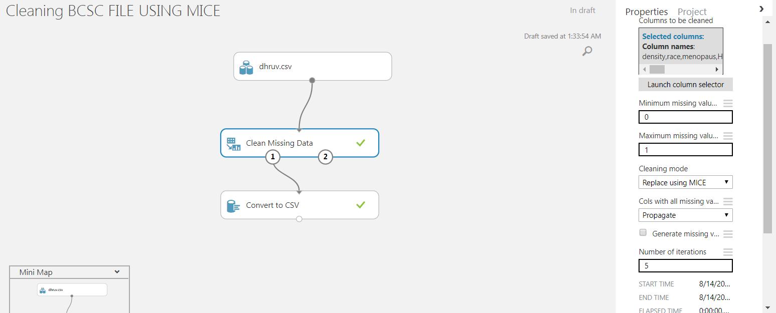
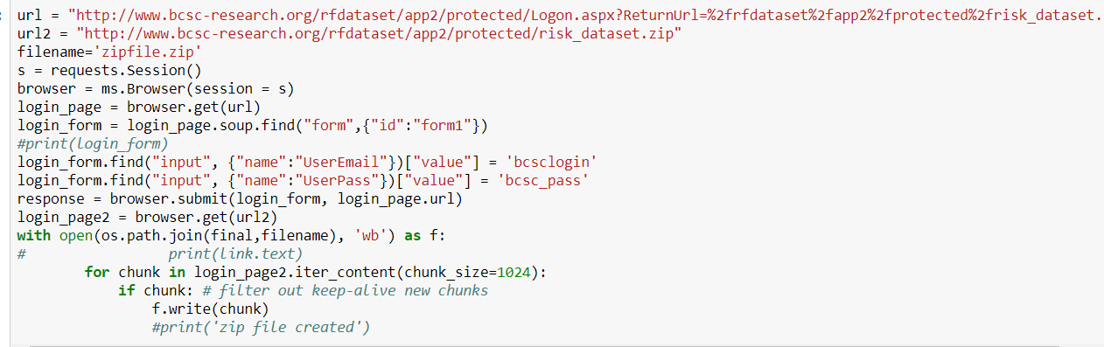
WEB SCRAPING AND PRE PROCESSING

Slide 5
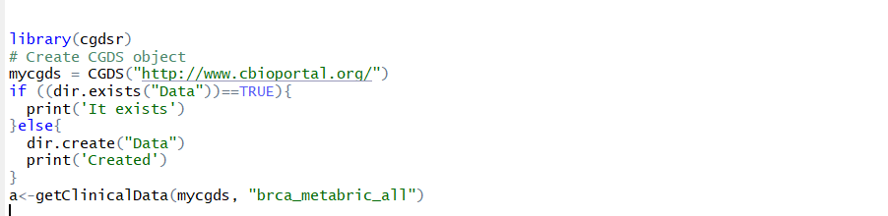
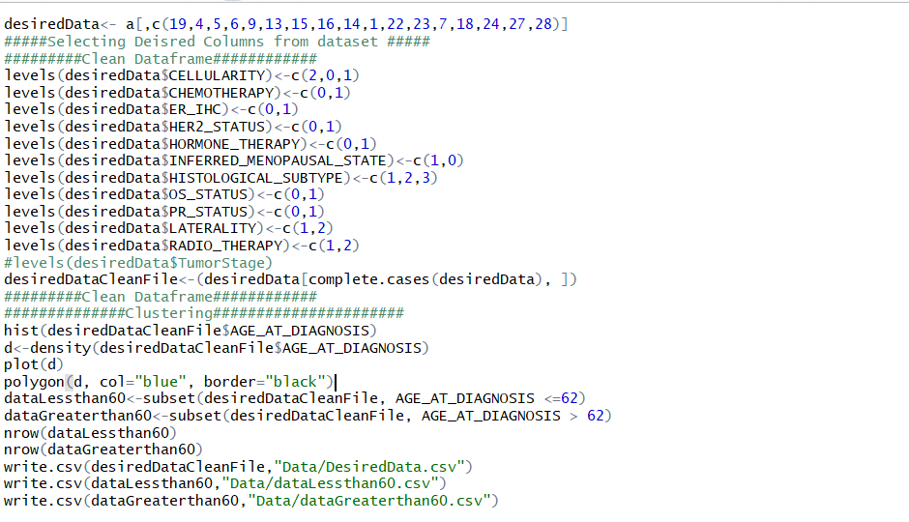
WEB SCRAPING AND PRE PROCESSING CONTD.

Slide 6
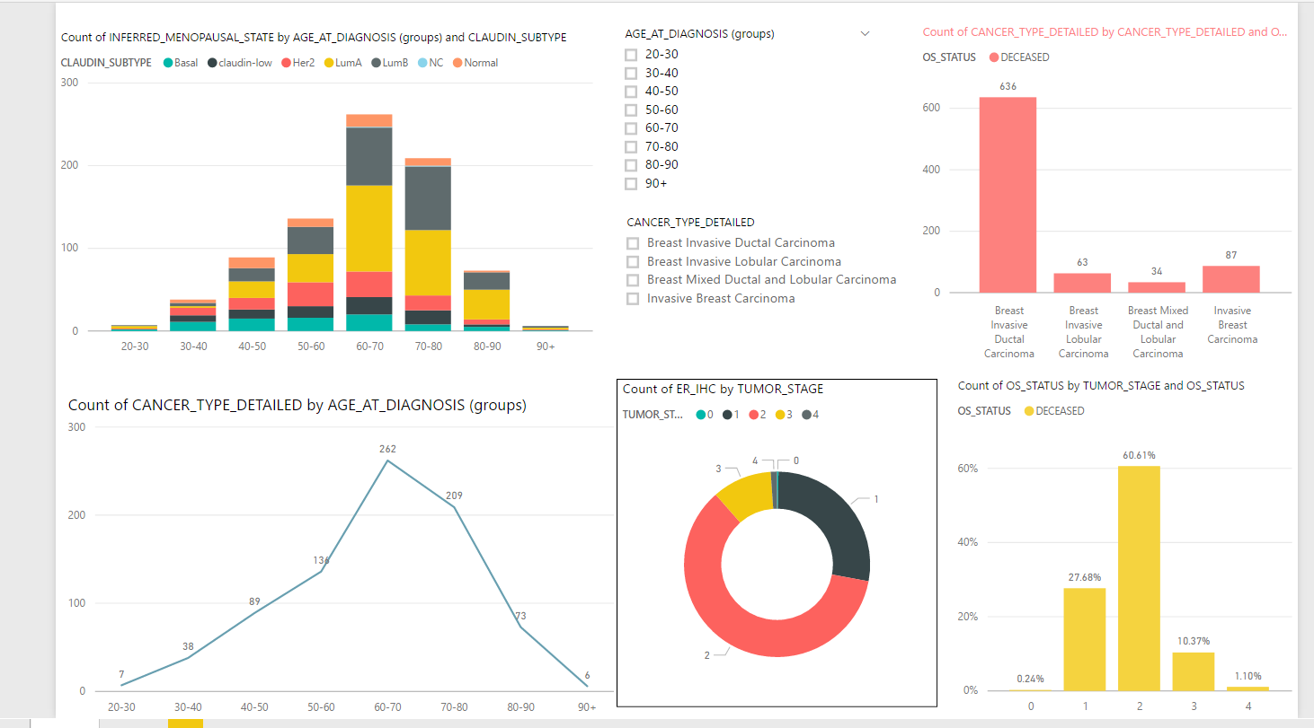
EDA

Slide 7
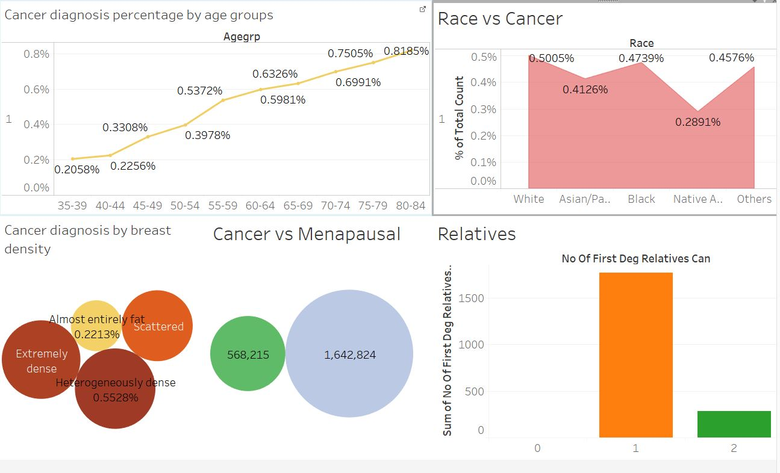
EDA - CONTD

Slide 8
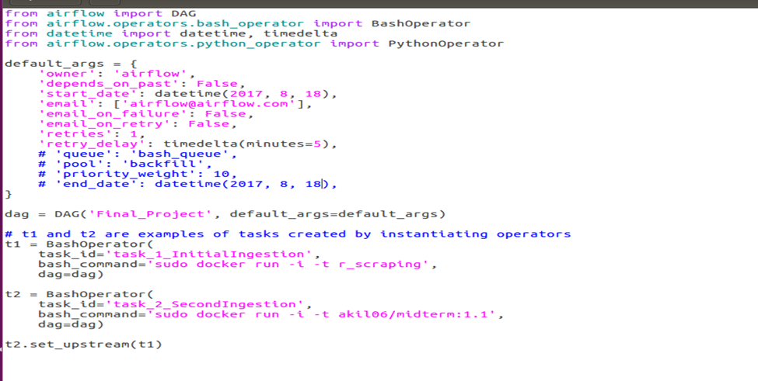
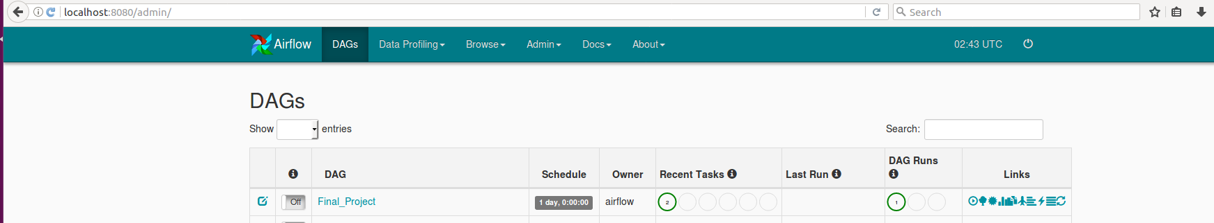
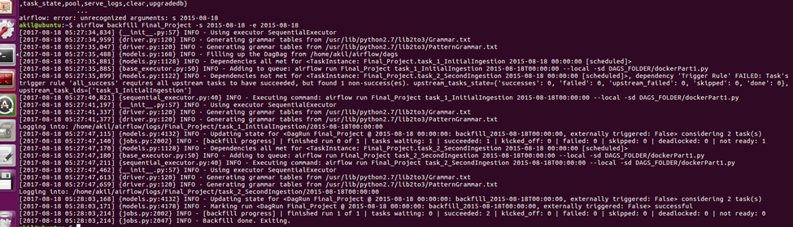
PIPELINE(Airflow)

Slide 9
DOCKER
There are two docker images one for extracting the Metabric dataset and one for BCSC dataset
The images are built upon R and Python base images respectively.
Commands to pull and run the images are:
Docker pull akil06/finalproject:image1.2
Docker pull akil06/finalproject:image2
Docker run akil06/finalproject:image1.2
Docker run akil06/finalproject:image2

Slide 10
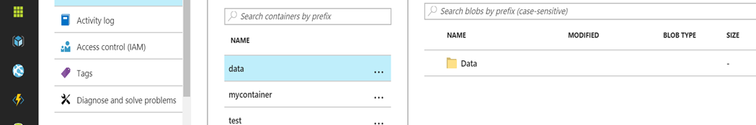
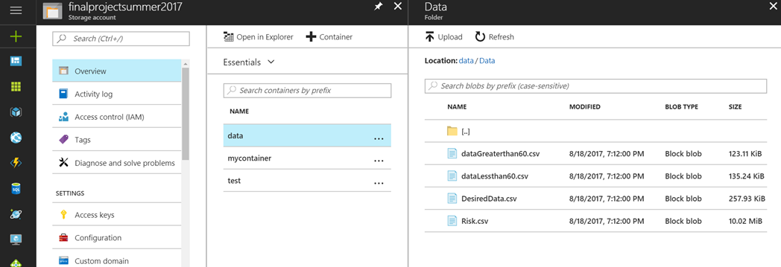
AZURE BLOBS
We transferred the data form the docker container to the Azure blobs

Slide 11
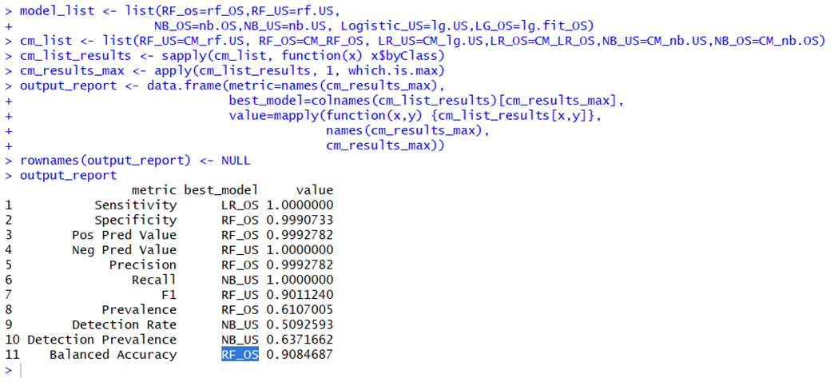
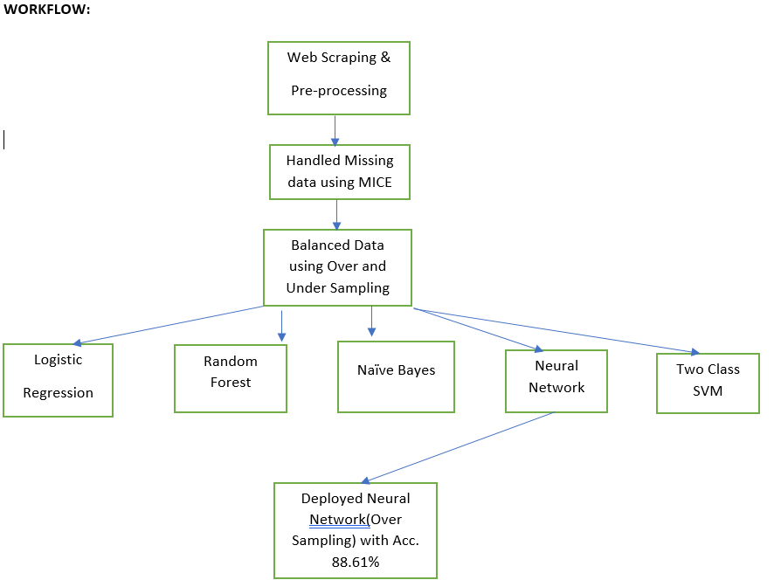
USE CASE:1 (Modeling) This use case is for the user to test the risk of getting cancer

Slide 12
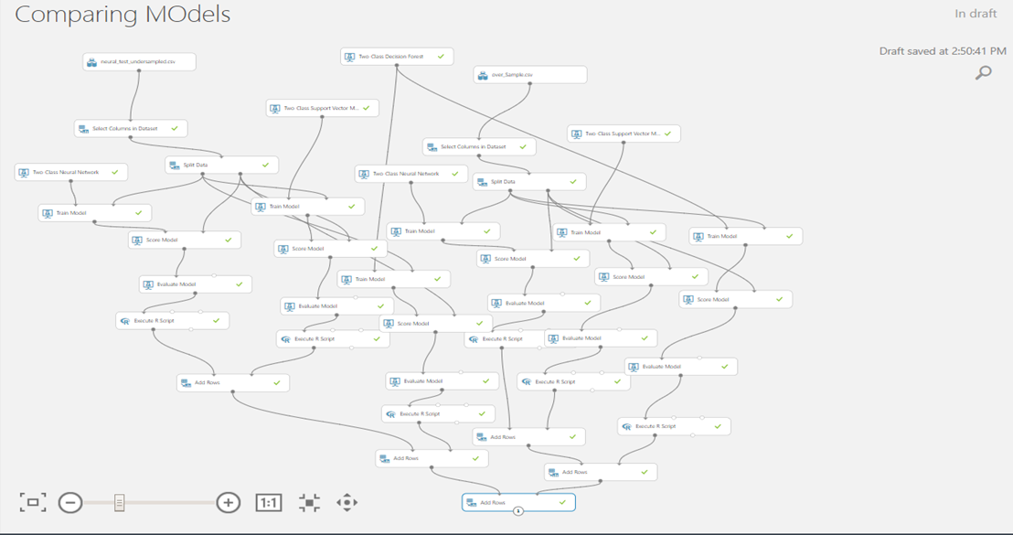
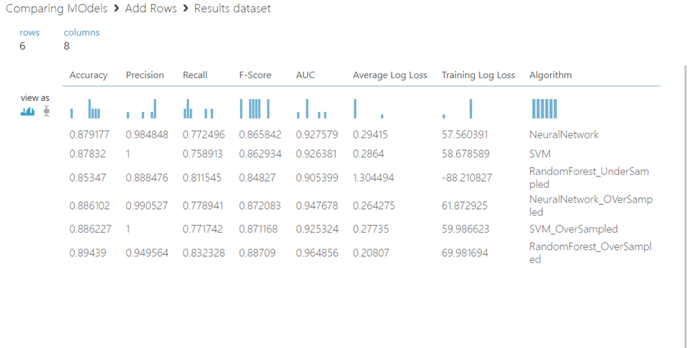
CONTD

Slide 13
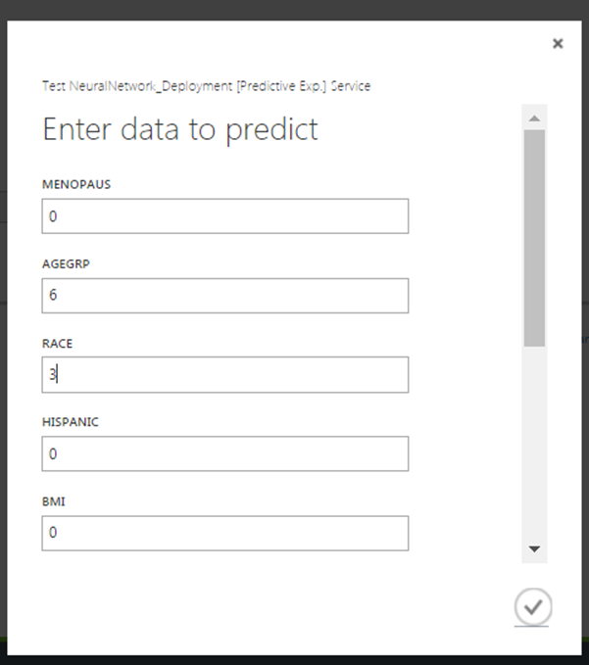
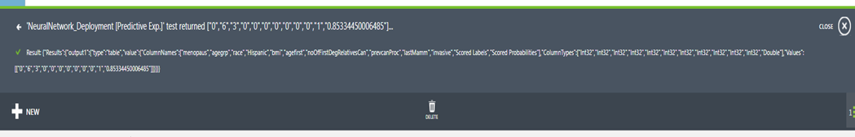
OUTPUT

Slide 14
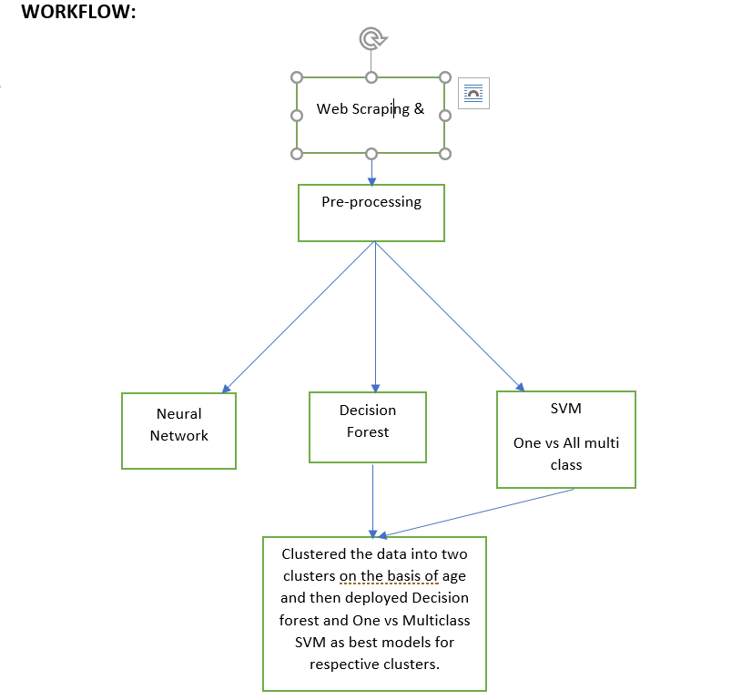
USE CASE 2: Classification of Breast cancer subtype:

Slide 15
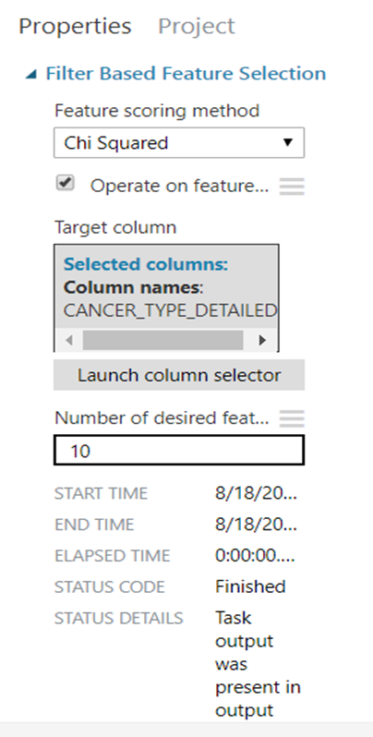
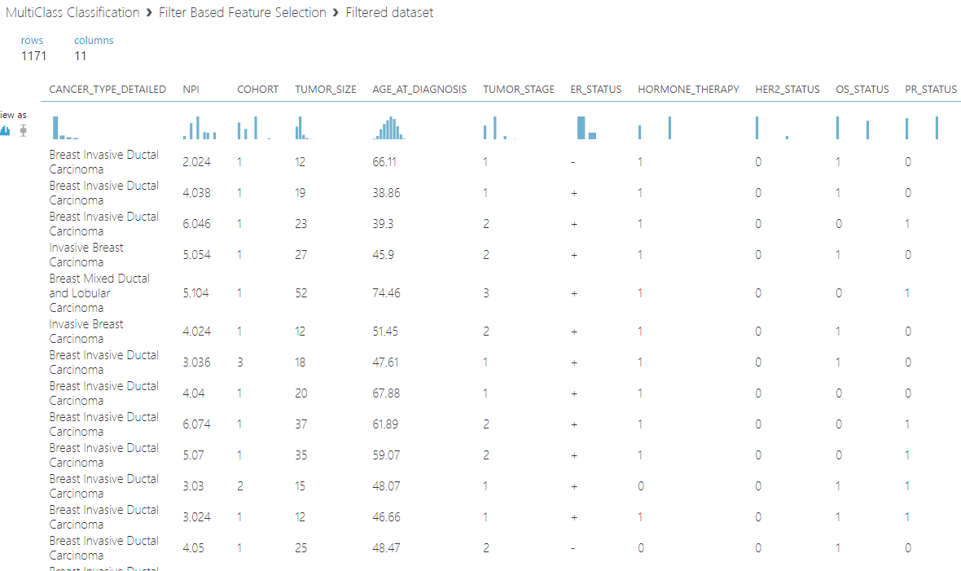
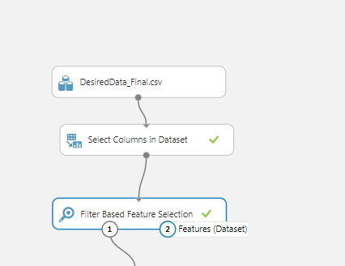
FEATURE SELECTION

Slide 16
Machine Learning Algorithms and Output:
To classify the types of the Breast Cancer with the data of results of patients vitals we found that the age at diagnosis of the patient is normally distributed . So we clustered the dataset into two clusters (age group <= 62 and age group >62) and then build the two models using this clustered data. The algorithms used are:
Multi Class Neural Networks
Multi Class Decision Forest
1 vs all Multi class SVM

Slide 17
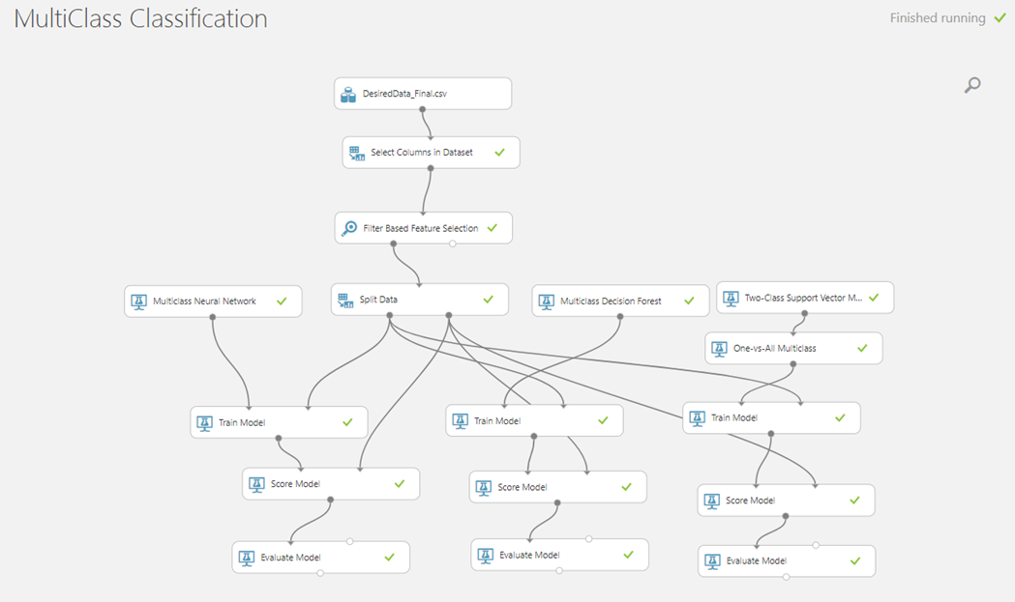
CONTD

Slide 18
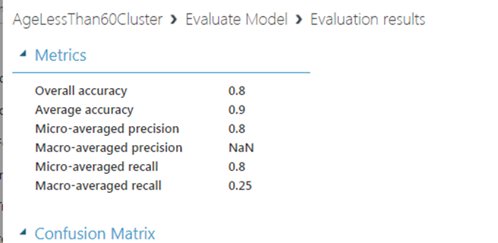
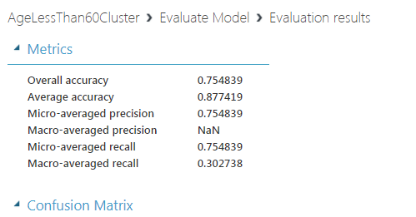
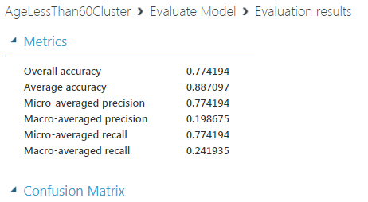
CONTD
SVM
NEURAL NETWORK
Decision Forest
The accuracy of the SVM gave better accuracy than the other models so we deployed SVM model for this category of cluster.

Slide 19
APPLICATION
The app for dealing the two above mentioned use cases is developed in
Python Flask
HTML
CSS
Java Scripts
And deployed as a Web App in IBM Bluemix
http://breastcancerassesment.mybluemix.net/

Slide 20

HOME PAGE

Slide 21
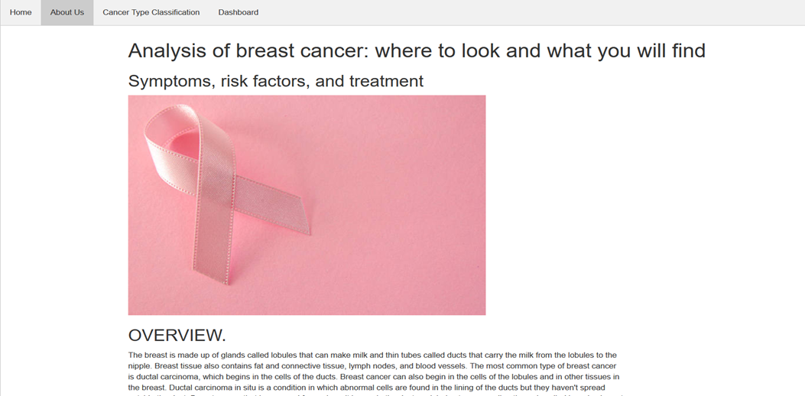
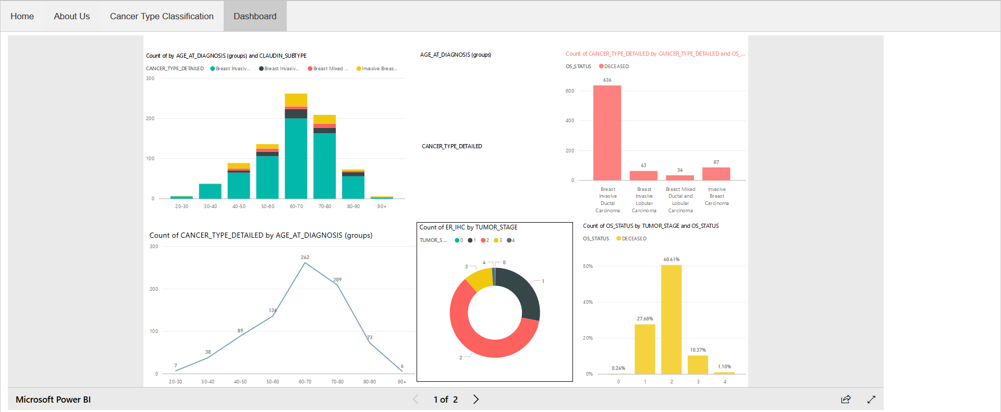
One of the tabs with the Power BI dashboard tab on the application

Slide 22
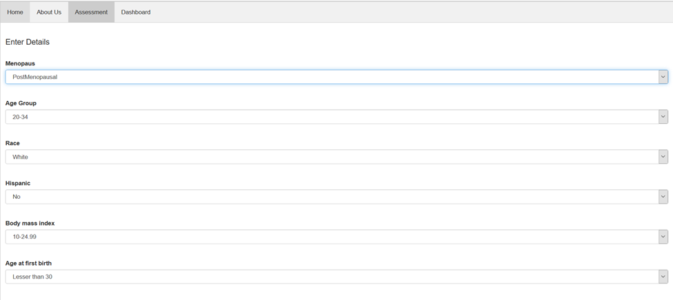


USE CASE 1
TWO DIFFERENT OUPUT for DIFFERENT INPUTS

Slide 23
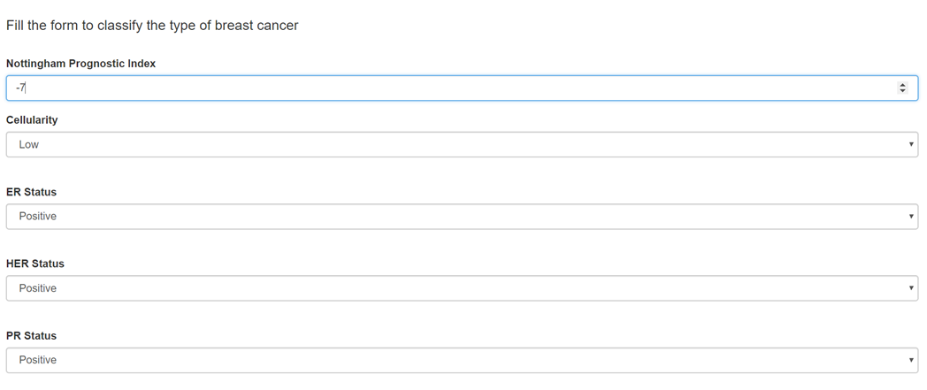
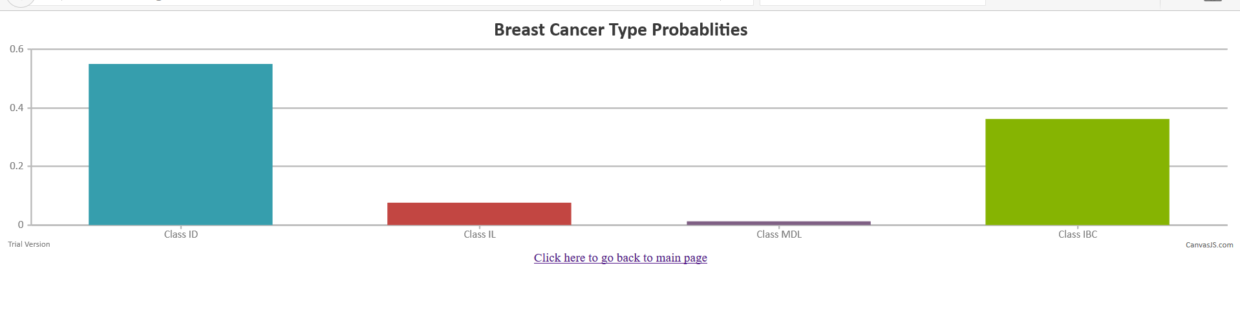
USE CASE 2: Classifying the tumor into types of Cancer:

Slide 24
THANK YOU

